Slide 1

Time Series Forecasting

Slide 2
What do we forecast
the weather
stock prices
traffic flow (cars, air traffic)
new customer signups
new covid cases
Notes:
annual google profits, beer production, monthly rainfall, retail sales, stock prices, electricity demand, traffix,

Slide 3
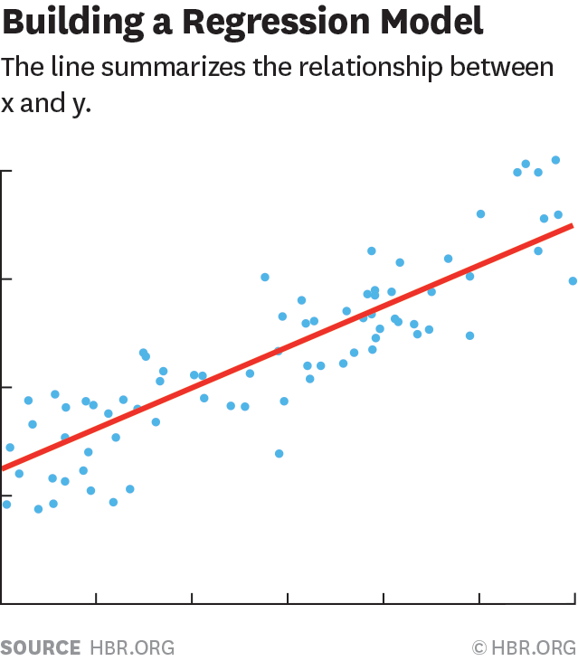
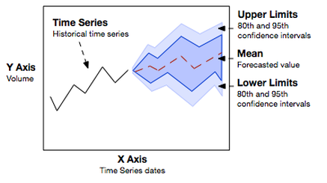

Forecasting methods
1. Qualitative
2. Causal models
3. Time series
analysis

Slide 4
Qualitative methods
1. Qualitative
Qualitative forecasting methods are primarily subjective and rely on human expertise and judgement
Most appropriate when little historical data are available like in the case of demand forecasts for new products
Popular qualitative forecasting methods are: Delphi Approach, Market research, Life Cycle analogy, informed judgement
Notes:
13

Slide 5
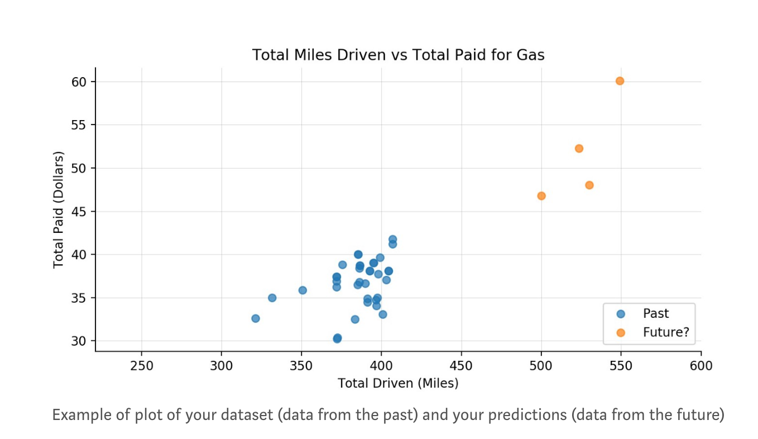
2. Causal models
Causal methods
Inbound calls received (x 1000)
Number of consultants
We can use data from the past to model the relationship between variables
e.g. simple linear regression, SVM, random forest, XGBoost etc.
Notes:
13
Causal model – predicts one dependent variables relative to other independent variables – usually a regression

Slide 6
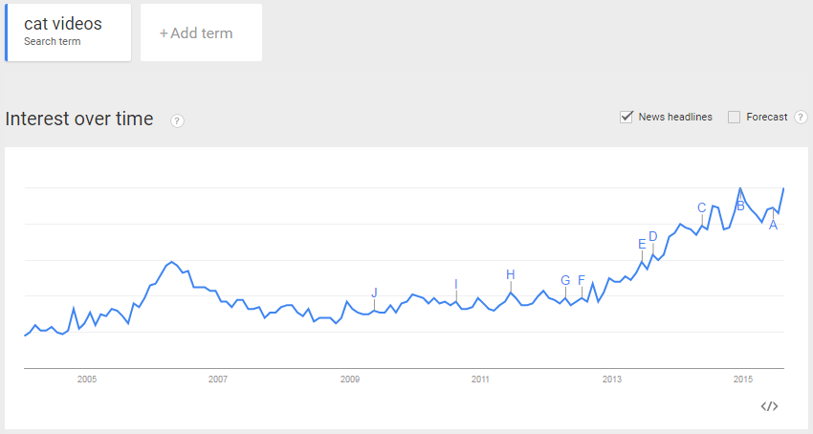
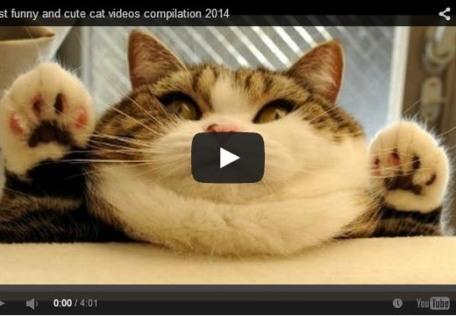
Time series analysis
3. Time series
analysis
What is time series analysis
Set of evenly spaced numerical data
Obtained by observing response variable at regular time periods
Forecast based only on past values
Assumes factors influencing past, present, & future will continue

Slide 7
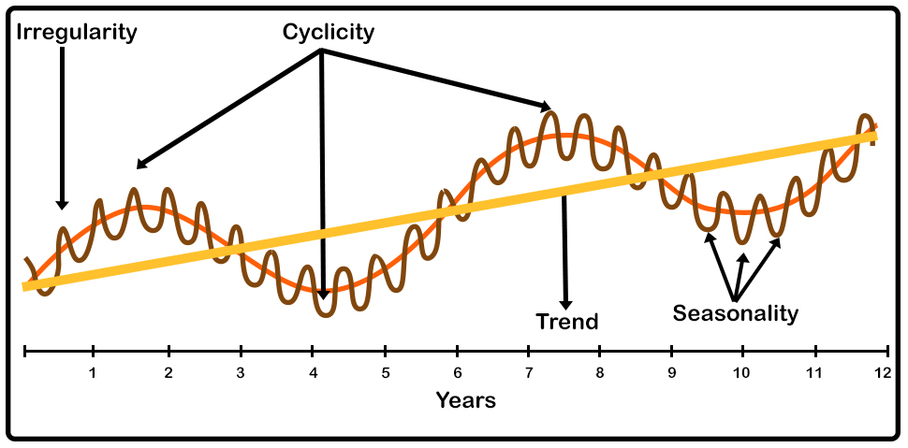
Time series components
Trend: Long term increase or decrease in the data
Cyclic: Data exhibits rises and falls that are not of fixed period (e.g. every 3 years)
Seasonal: patterns that exists due to the calendar (e.g. quarter, monthly, day of week.
Irregular: Erratic or residual fluctuations

Slide 8
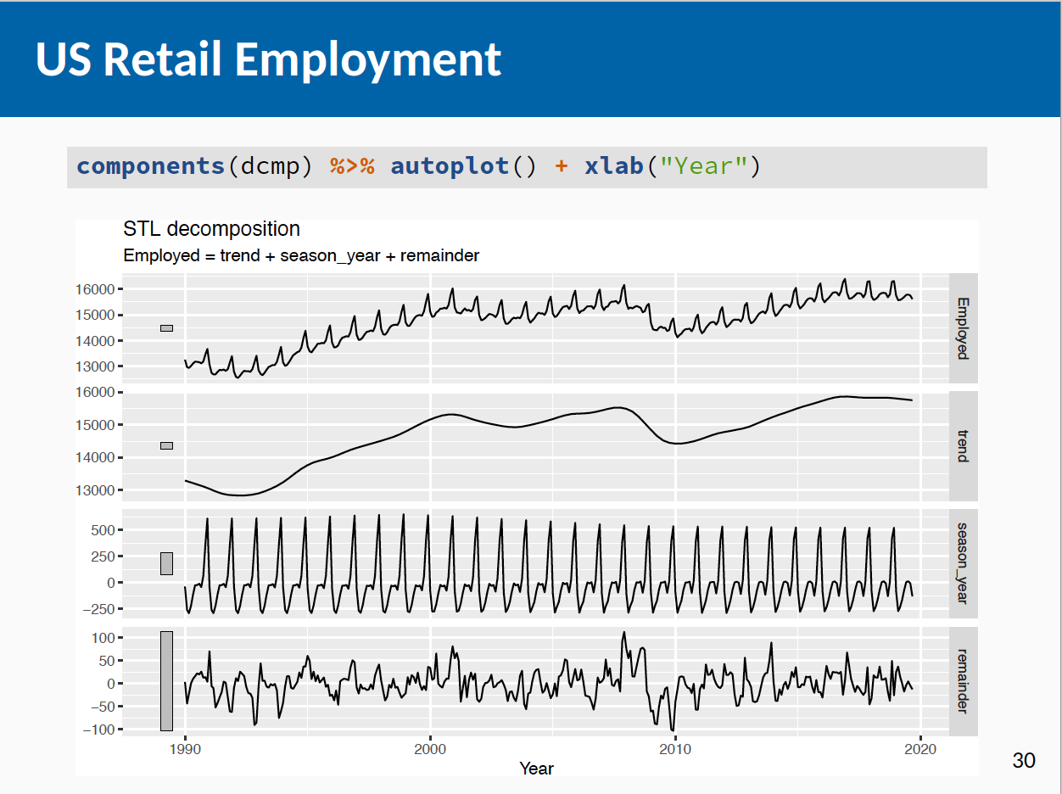
Time series components

Slide 9
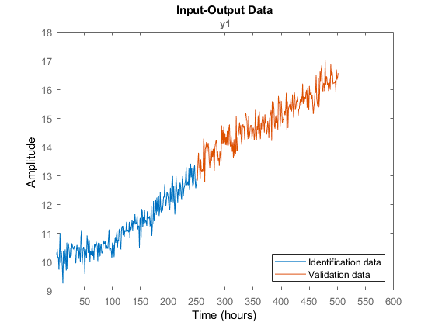
Time series forecasting

Slide 10
Forecasting steps
1) Problem definition
2) Gathering info
3) Exploratory analysis
4) Choosing and fitting a model
5) Evaluating and using a forecasting model

Slide 11
Forecasting steps
1) Problem definition
What are we trying to forecast, who will be using it, how the info will be used etc.
2) Gathering info
Data! Often we need to talk to people who understand the data as well so we understand what might be causing trends, or blips etc.
3) Exploratory analysis
Always start with graphing the data!
are there patterns?
is there a trend, is seasonality present, is there evidence of longer term cycles?
are there outliers or big dips we might need help explaining?

Slide 12
Forecasting steps
4) Choosing and fitting a model
The best model to use depends on the availability of historical data, the strength of relationships between the forecast variable and any explanatory variables, and the way in which the forecasts are to be used.
It is common to compare two or three potential models. Each model is itself an artificial construct that is
based on a set of assumptions (explicit and implicit) and usually involves one or more parameters which must
be estimated using the known historical data.

Slide 13
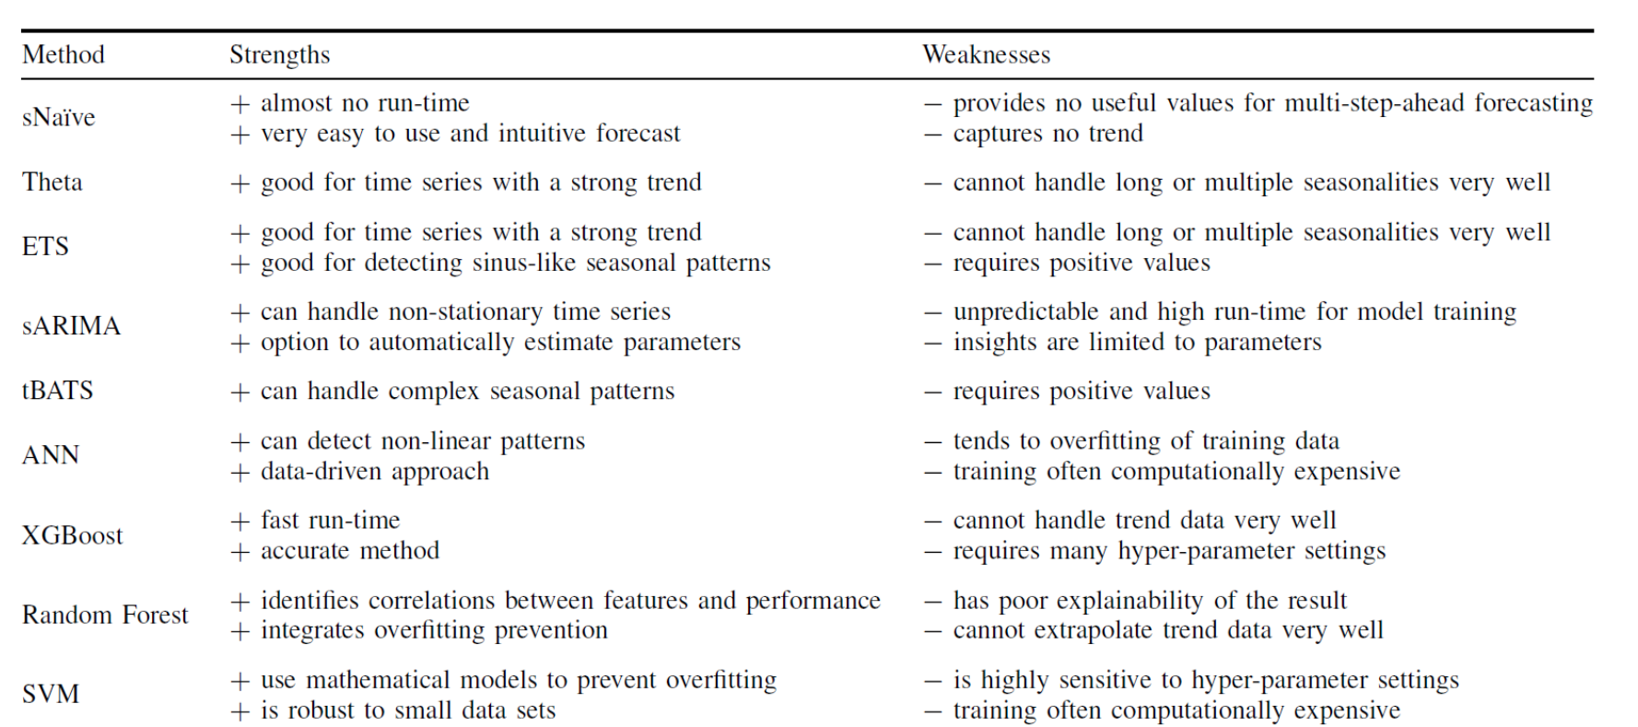
Choosing the model
3. Time series
analysis
2. Causal models

Slide 14
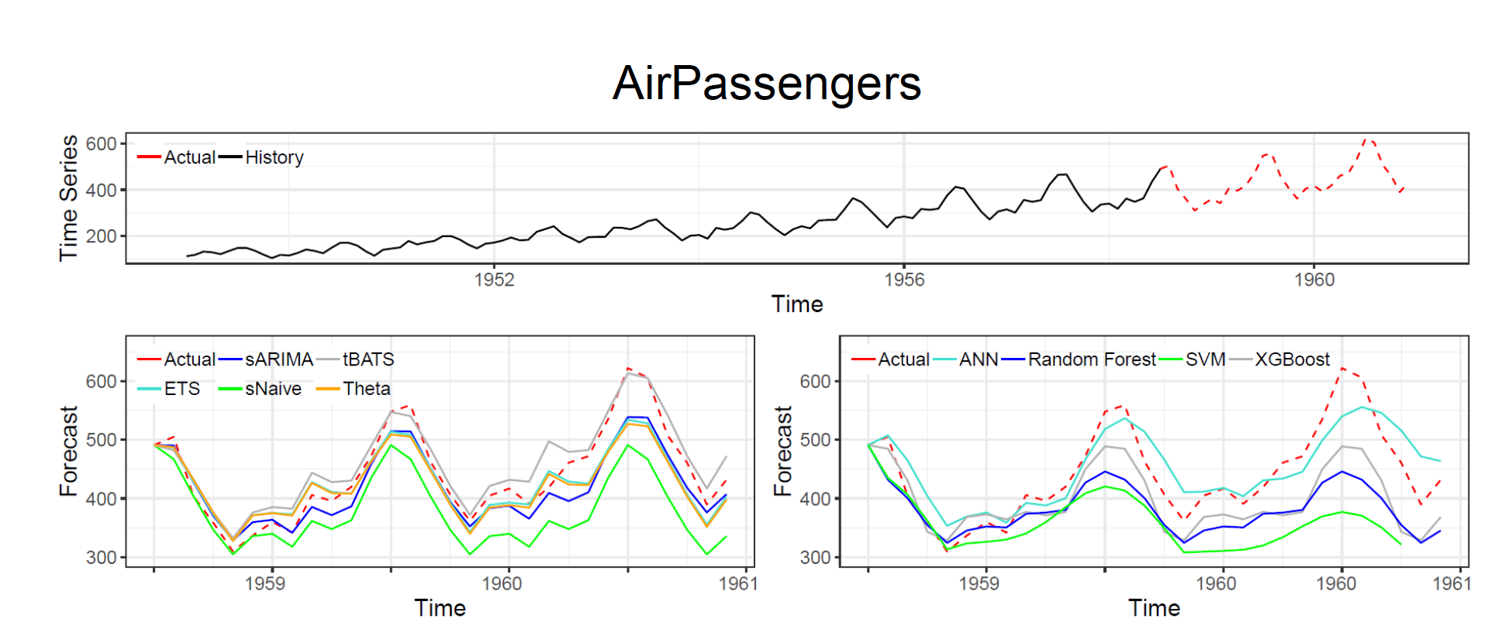
Choosing the model
3. Time series
analysis
2. Causal models

Slide 15
Forecasting steps
5) Evaluating and using a forecasting model
Once a model has been selected and its parameters estimated, the model is used to make forecasts.
The performance of the model can only be properly evaluated after the data for the forecast period have become available.
But a number of methods have been developed to help in assessing the accuracy of forecasts.

Slide 16
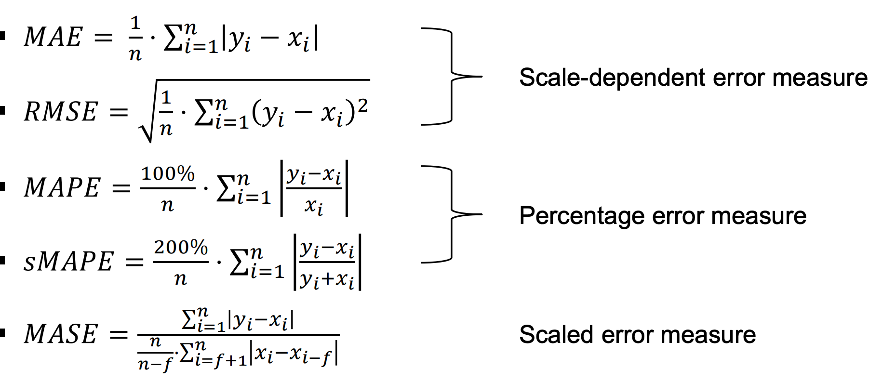
Evaluation of the model
Further explanation and other options here:

Slide 17
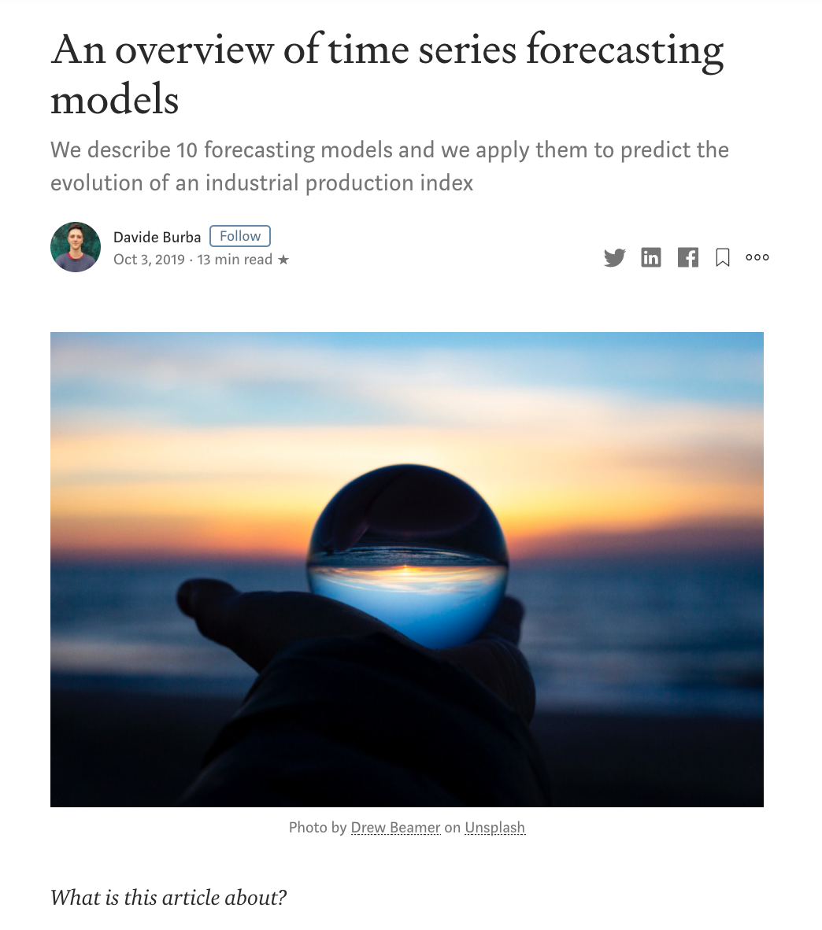
A nice overview example
source

Slide 18
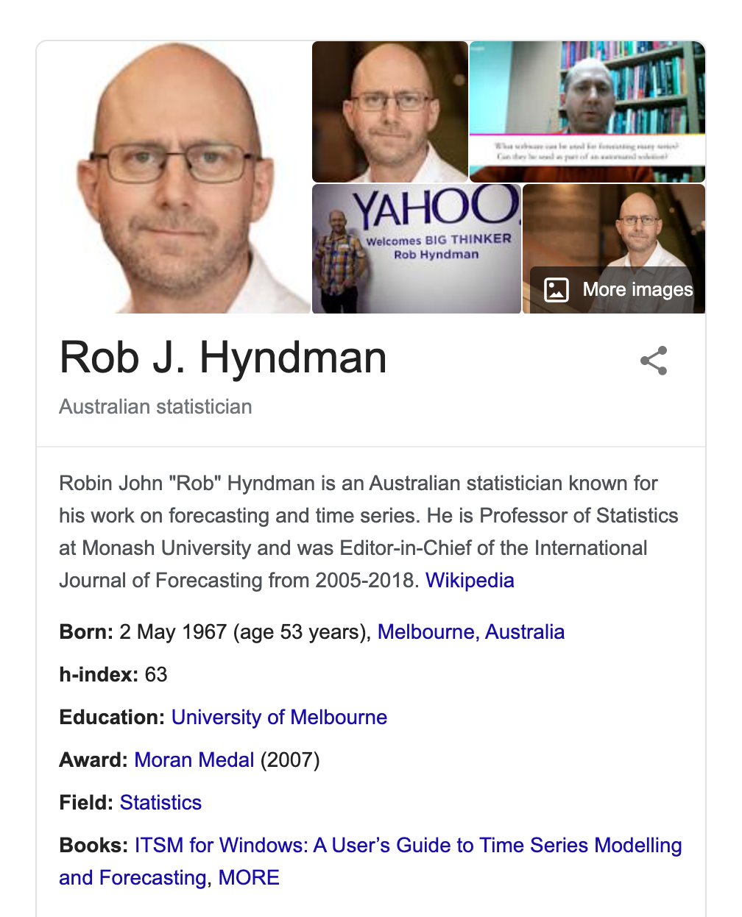
Additional reading

Slide 19
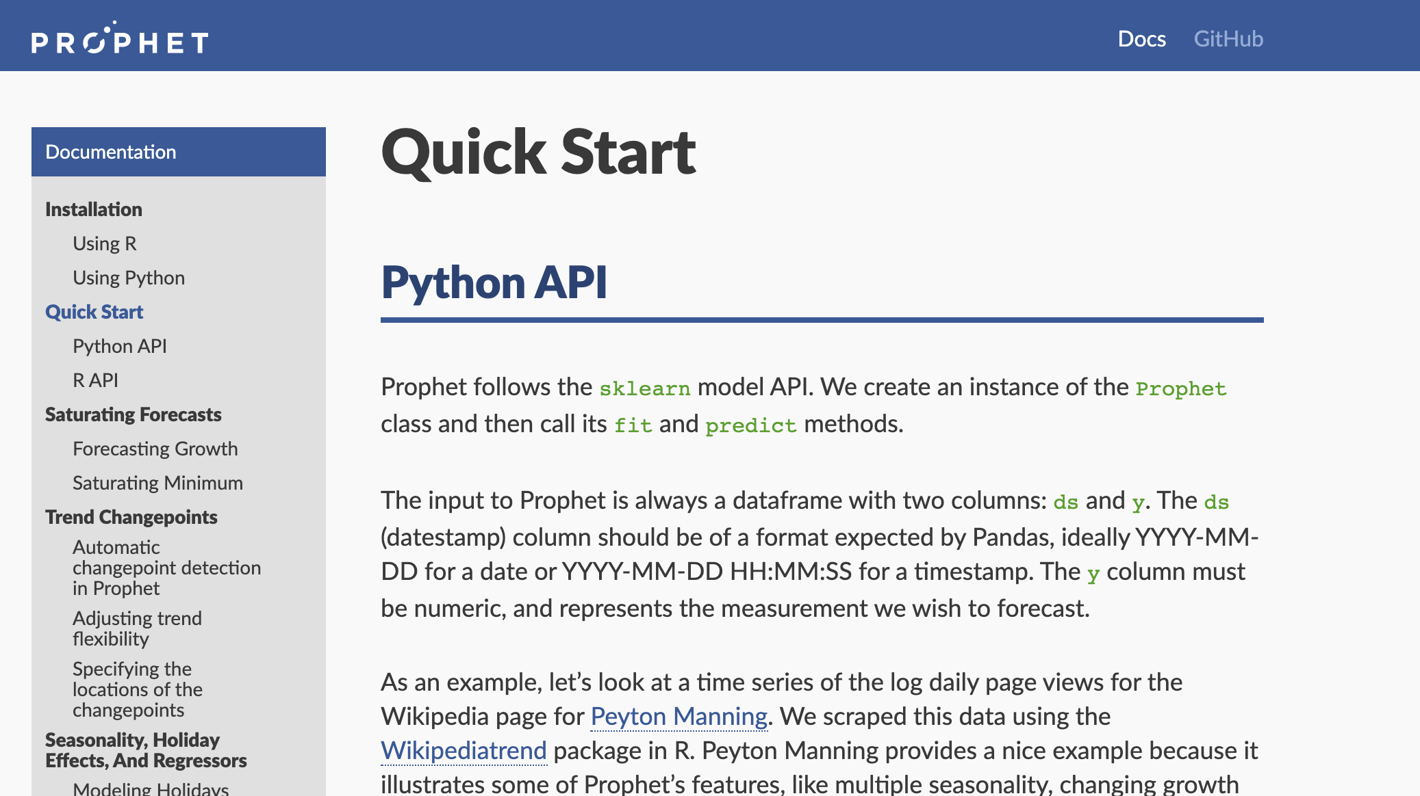
Choosing the model
source

Slide 20
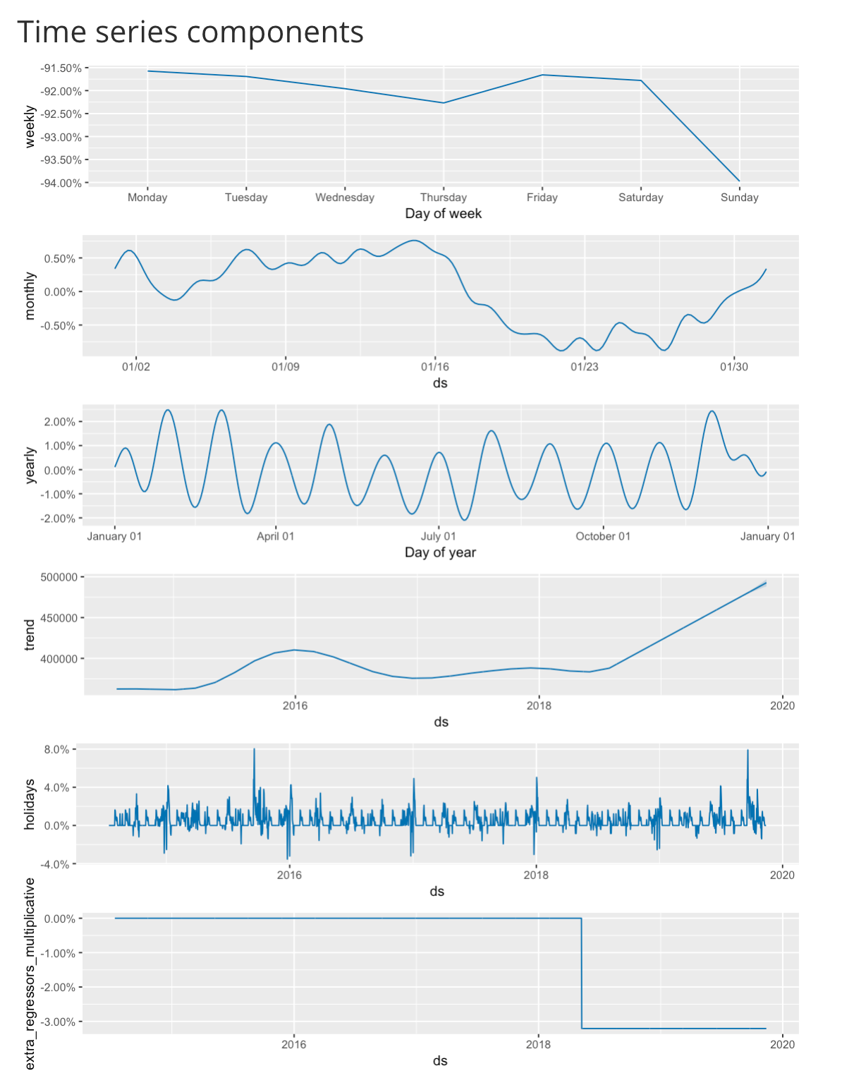
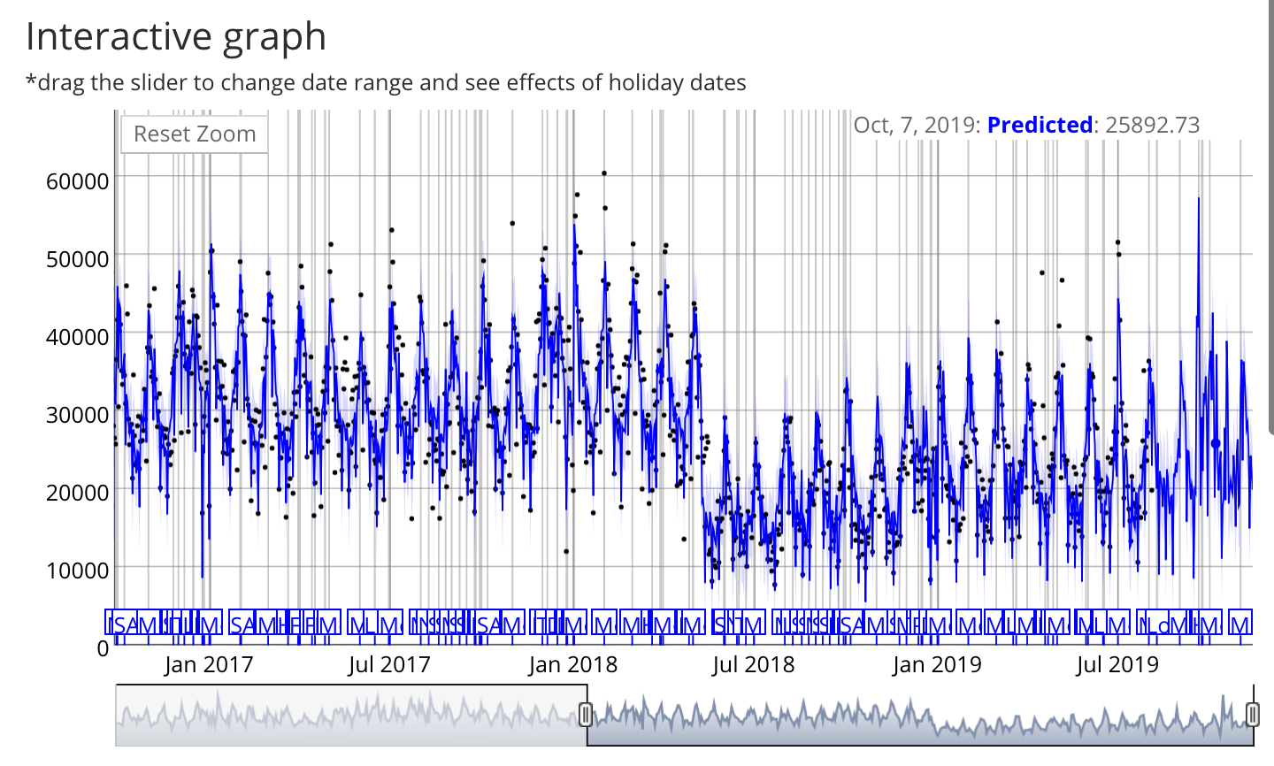
Forecasting with Prophet

Slide 21
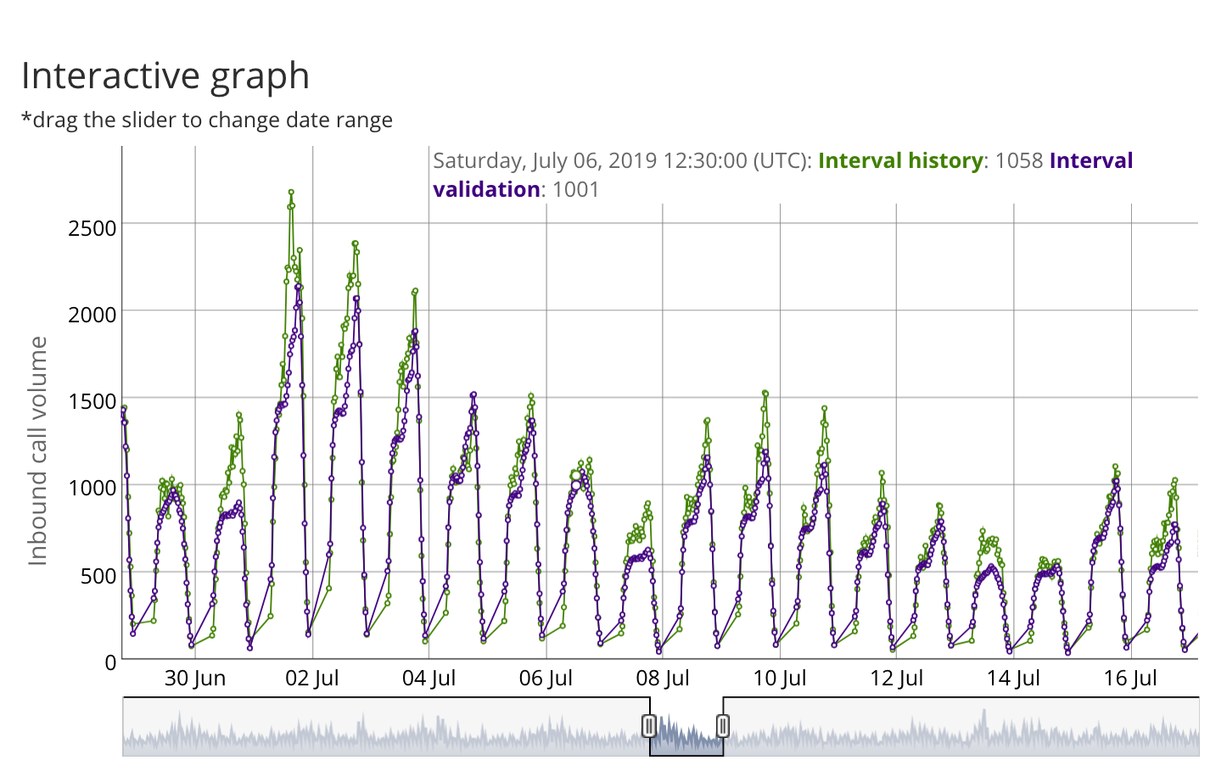
Forecasting with Prophet

